Slide 1
Office 365 Development

Slide 2
Course Agenda
Deep Dive into Integrating Office 365 APIs with Web Applications
Module 1: Deep dive into Mobile Development with Office 365 and Cordova
Module 2: Deep dive into native Universal Windows App Development with Office 365 APIs
Module 3: Deep dive into native Xamarin Development with Office 365 APIs

Slide 3
Deep Dive into native Xamarin Development with Office 365 APIs
Speaker
Speaker

Slide 4

Agenda
Xamarin Development Overview
Developing Xamarin Apps
Developing for Office 365
Creating Portable Xamarin Apps

Slide 5
Xamarin Development Overview

Slide 6
What is Xamarin?
A Commercial Product
You must pay for a Xamarin license
You can get a free 30-day trial (90-day trial available for MSDN subscribers)
Development toolset for cross-platform development
Android
iOS
Windows Phone
Development toolset based on the .NET framework
You write code using C# and the .NET framework class libraries

Slide 7
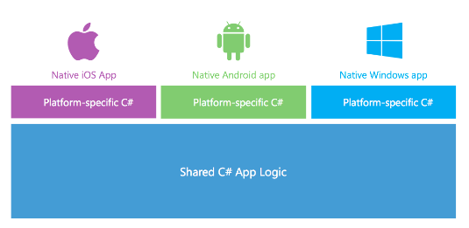
Supported Platforms
You can use Xamarin to build apps for the following devices and platforms:
Android 4 and later (4.4 provides the best developer experience)
iOS 6 and iOS 7
Windows 8 (Windows Store)
Windows Phone 8

Slide 8
Challenges with a Common Approach
Comparing Android, iOS and Windows Phone
Significant differences in toolsets
Significant differences in UI/UX models
Significant differences in execution models
Bringing CLR and .NET to Android and iOS is difficult
Each platform has unique runtime environment
Environments very different from CLR
Both environments significantly difference from each other

Slide 9
.NET on Android and iOS
CLR and .NET created for Windows
CLR stands for “Common Language Runtime)
CLR ported to Linux with Mono project
Mono extended to Android and iOS as Free Software
iOS
MonoTouch
Windows OS
Linux
CLR & .NET
Mono
CLR & .NET
Android
Mono for Android

Slide 10
The Xamarin Platform
Xamarin’s mission is to make Mono successful
Use of Xamarin involves licensing fees
Xamarin continually invests to keep update-to-date versions of CLR and .NET
iOS
iOS
MonoTouch
Xamarin.iOS
Linux
Mono
CLR & .NET
Android
Android
Mono for Android
Xamarin.Android
Free Software
Commercial Licensing

Slide 11
Xamarin on Android Architecture
App
.NET APIs
Android
Bindings
MCW
android.*
java.*
Mono Runtime
ACW
Dalvik Runtime
Android Kernel

Slide 12
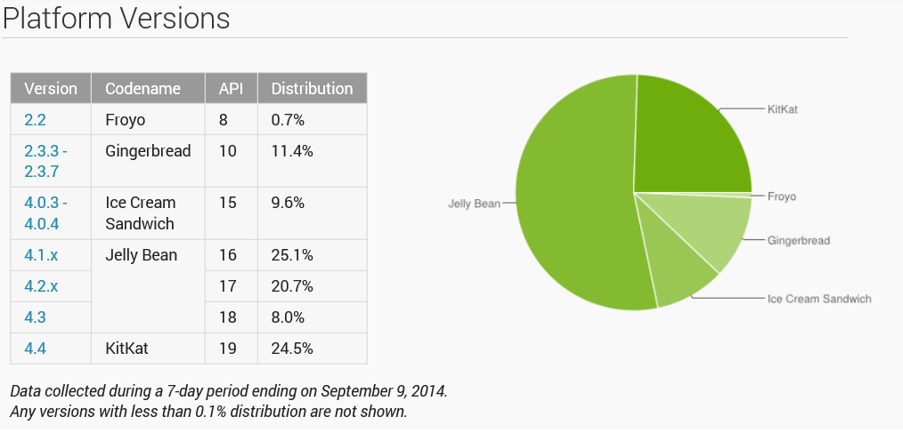
Android usage statistics from http://developer.android.com/about/dashboards/index.html

Slide 13
Xamarin on iOS Architecture
Apple does not allow for runtimes on iOS
App must be packages with everything it needs to run on iOS
Compilation of app must be done on computer with iOS not Windows
App
Application Code
.NET APIs
iOS
Bindings
iOS

Slide 14
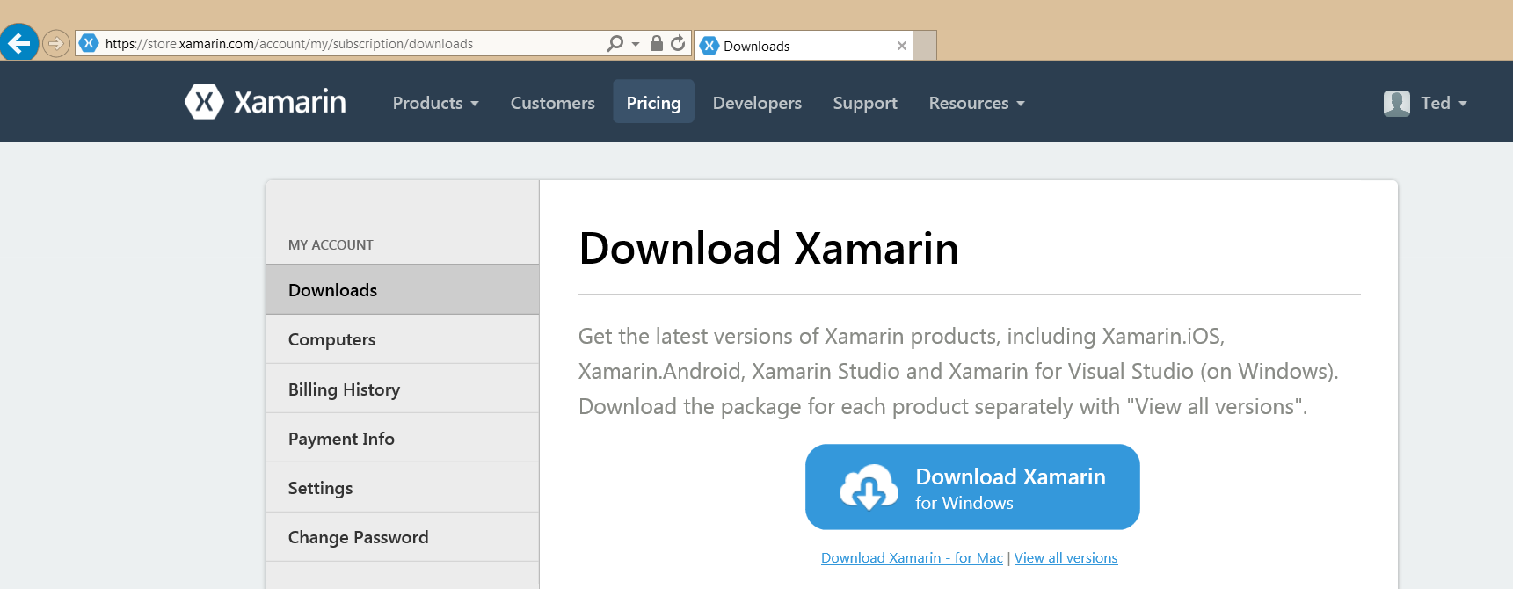
Xamarin Setup
Visual Studio 2013 with Update 3
Install Xamarin Studio

Slide 15
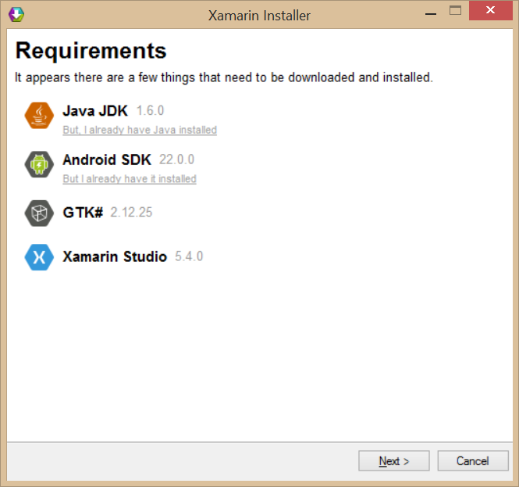
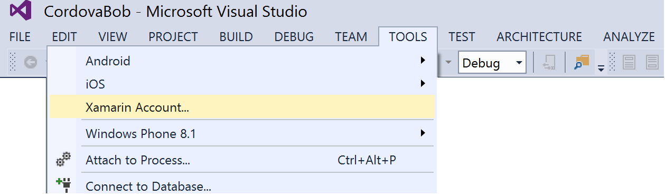
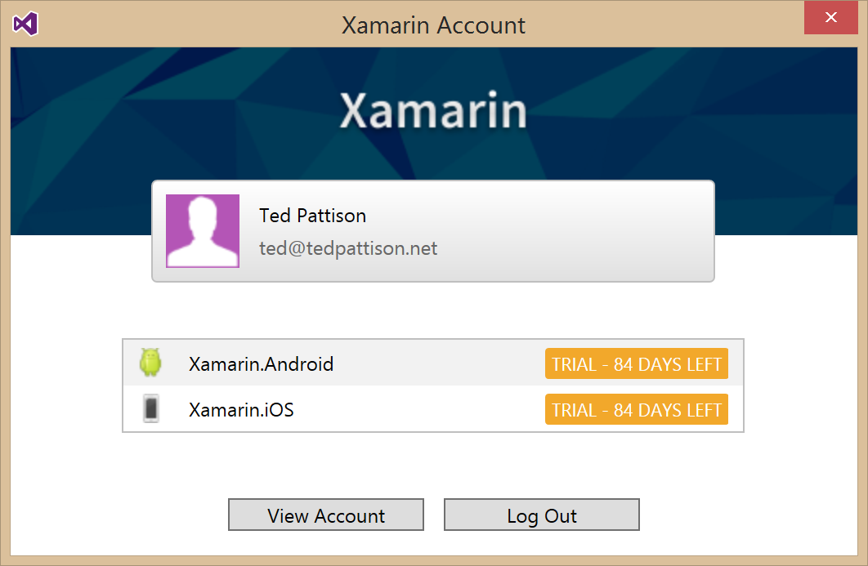
Xamarin Installer
What does it install?
Integration support into Visual Studio
Java JDK
Android SDK
GTK# (UI Toolkit for mono and .NET)
Xamarin Studio

Slide 16
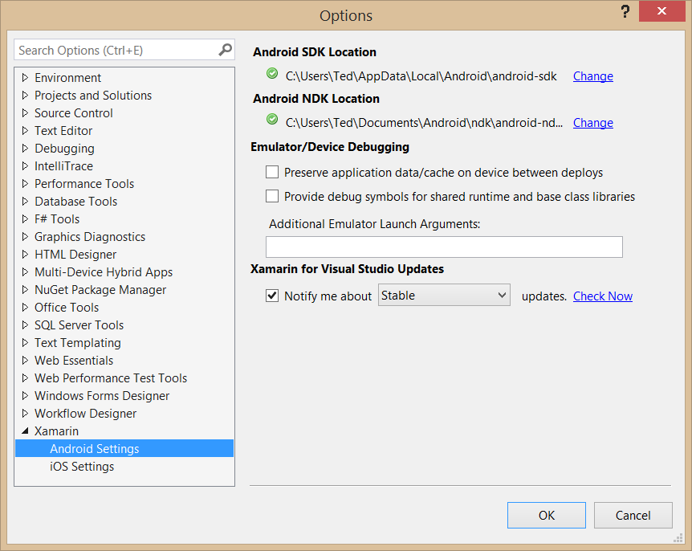
Tools > Options > Xamarin

Slide 17
Developing Xamarin Apps

Slide 18
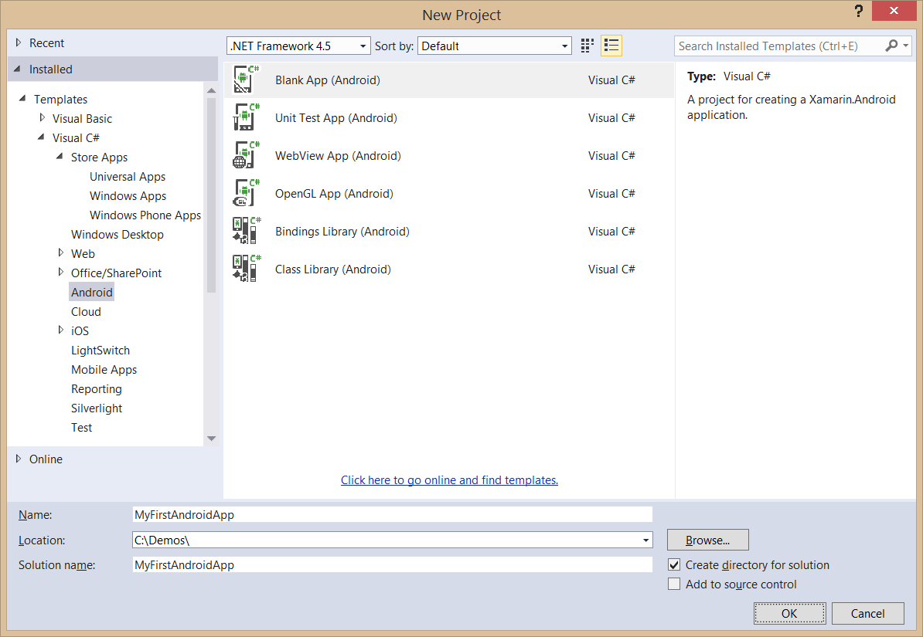
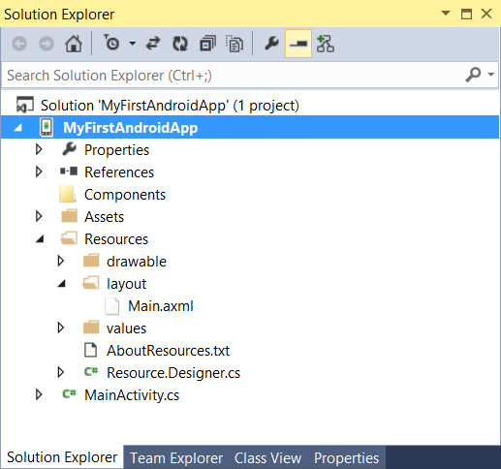
Creating an Android App Project

Slide 19
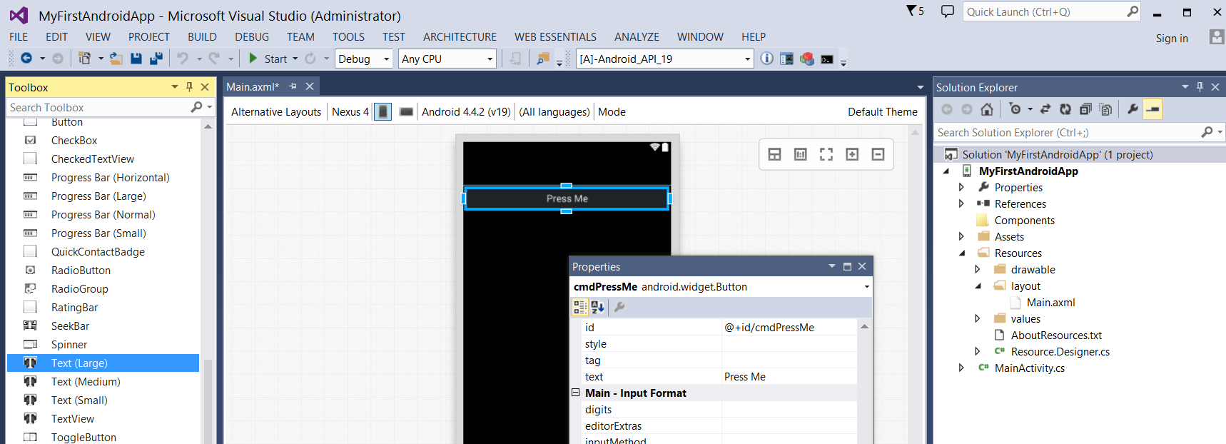
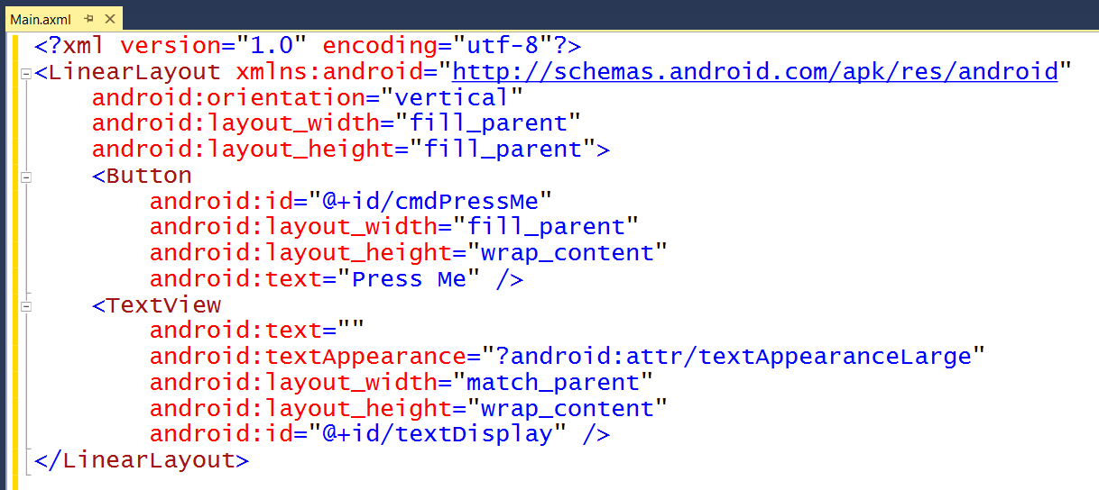
Android Layouts
UI layout decoupled from UI management code
UI Layouts created in XML-based resource files with .axml extensions
Visual Studio provides Android layout design editor

Slide 20
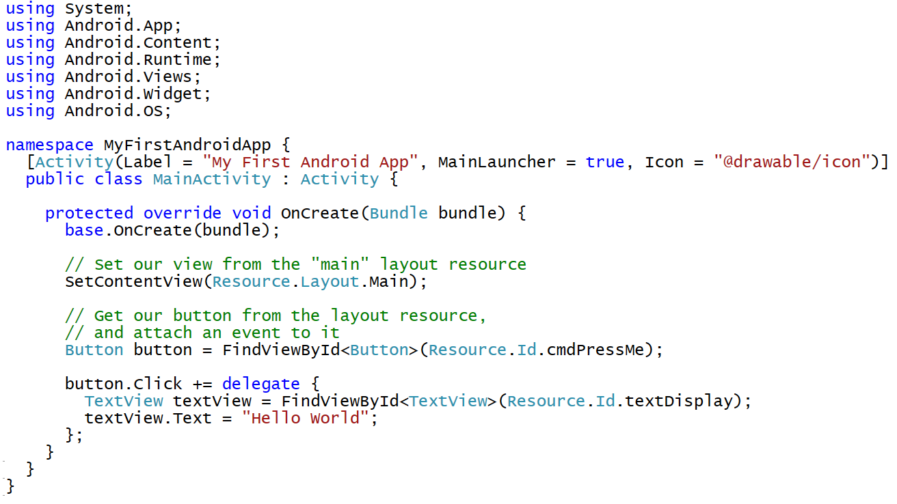
Activity-based User Interface Code

Slide 21
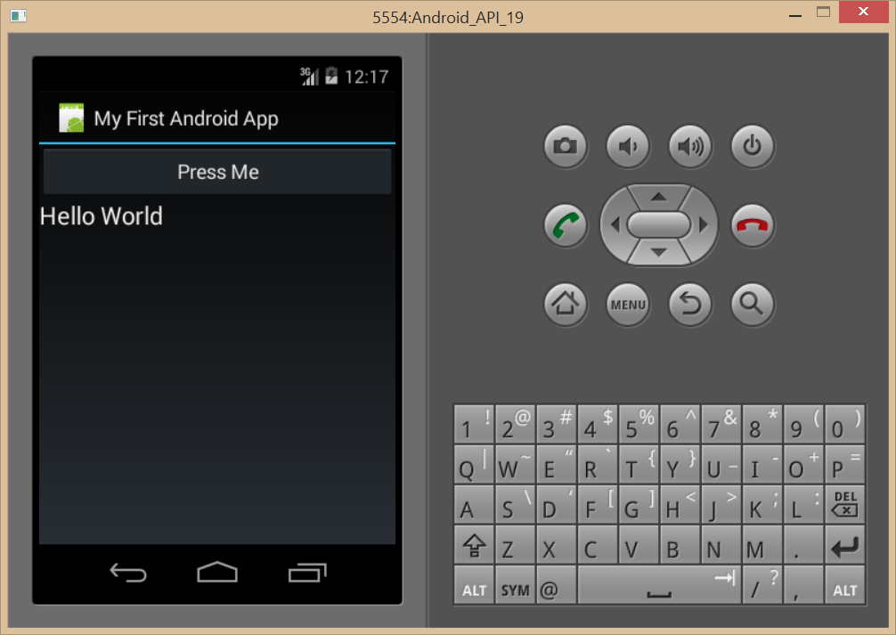
Debugging with an Android Emulator

Slide 22
demo
Creating and Testing an Android App using Xamarin

Slide 23
Developing for Office 365

Slide 24
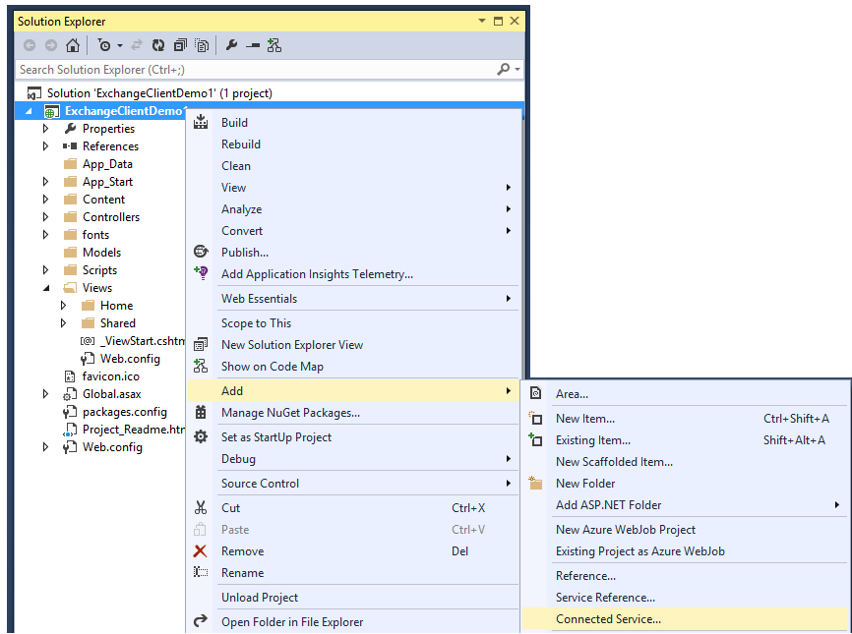
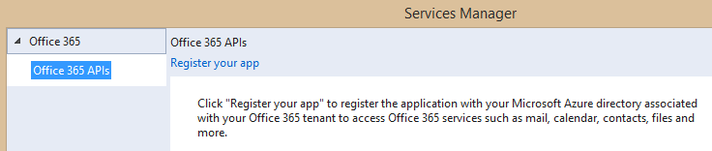
Adding Connected Services
1
Project > Add > Connected Service…
2
Register your app

Slide 25
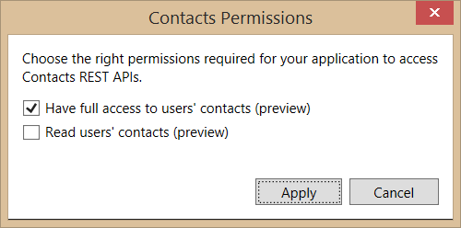
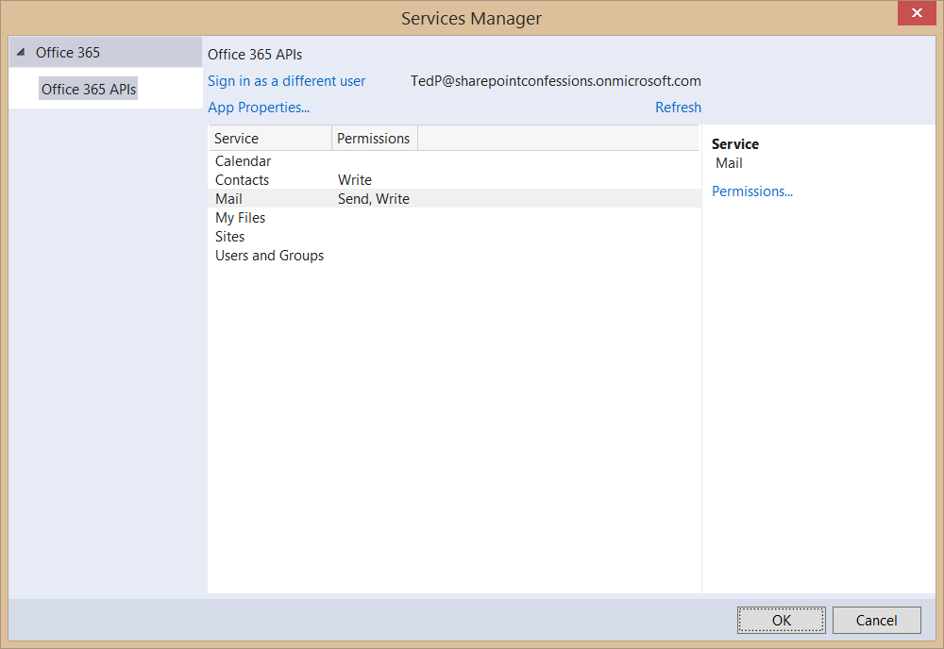
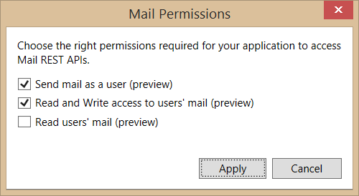
Connected Services Permissions
3
Select required app permissions

Slide 26
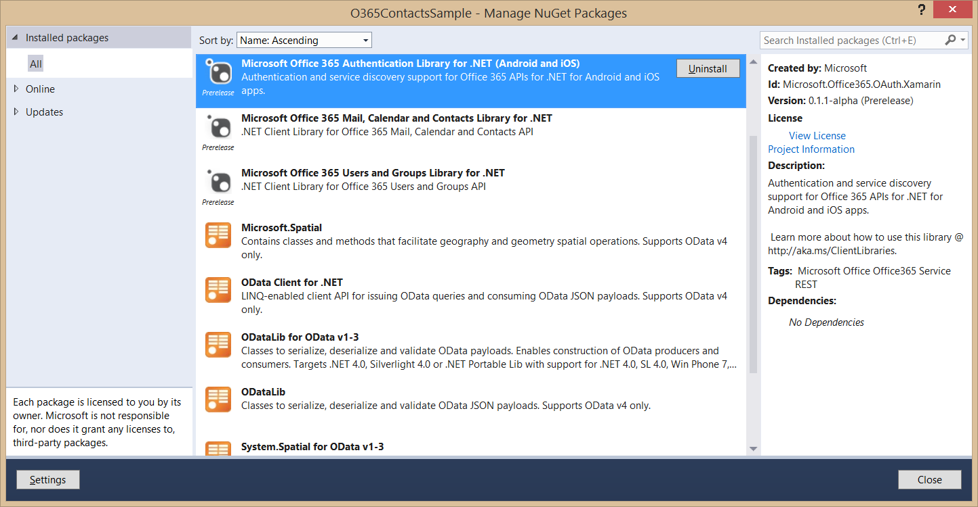
Nuget Packages Added with Connected Services
These packages are added to project when adding a Connected Service

Slide 27
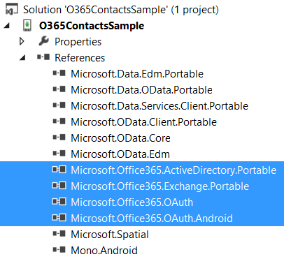
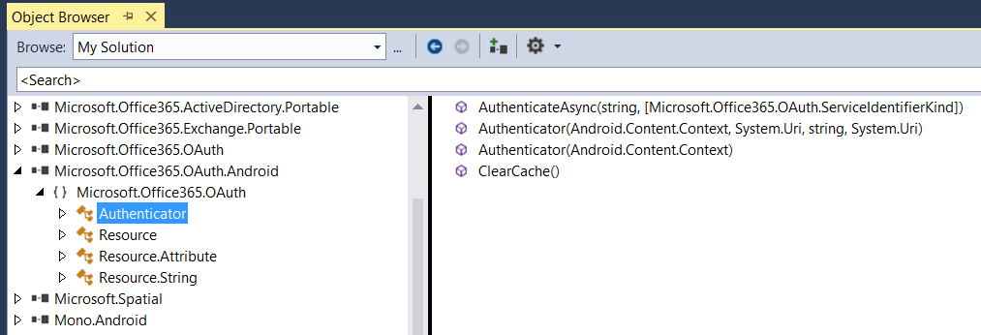
Assemblies Added with Connected Services
These assemblies are added to project when adding a Connected Service

Slide 28
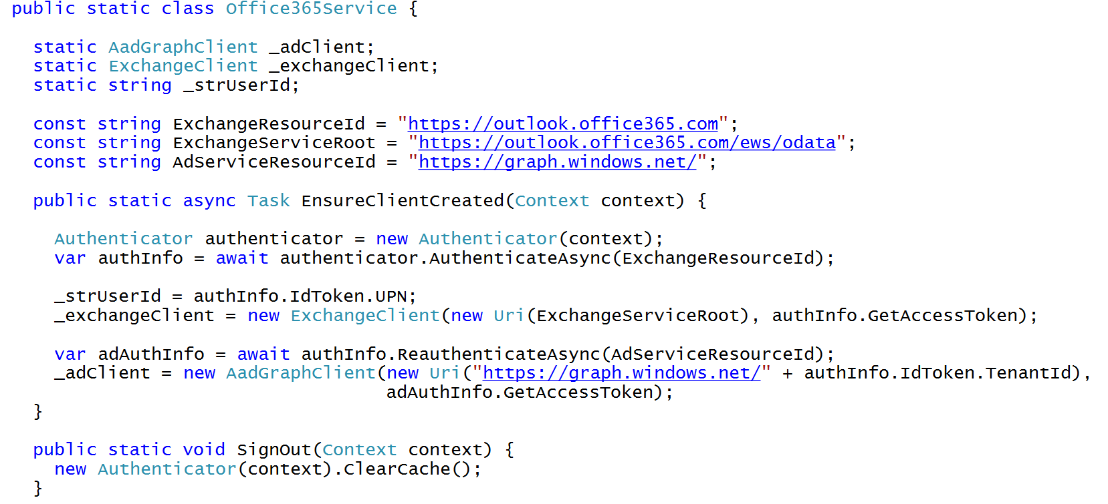
C# Code to Authenticate the User

Slide 29
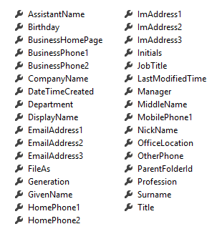
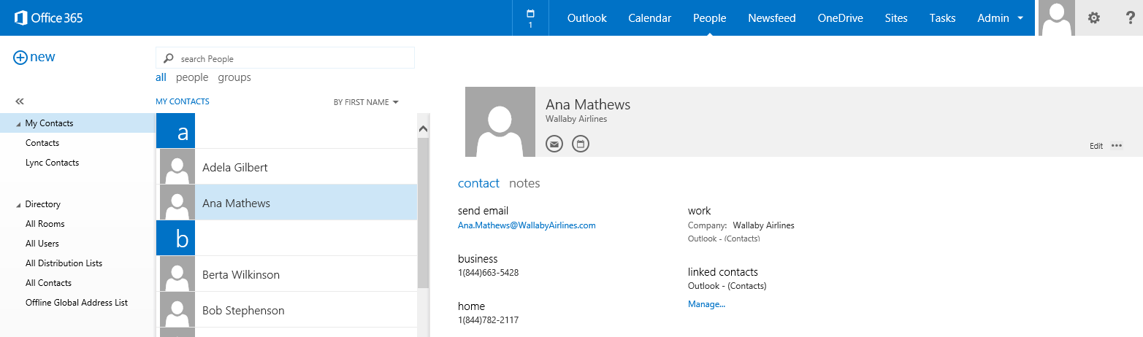
Office 365 Contacts
Common API operations
Reading contacts
Searching for contacts
Creating contacts
Deleting contacts
Editing events
Contact

Slide 30
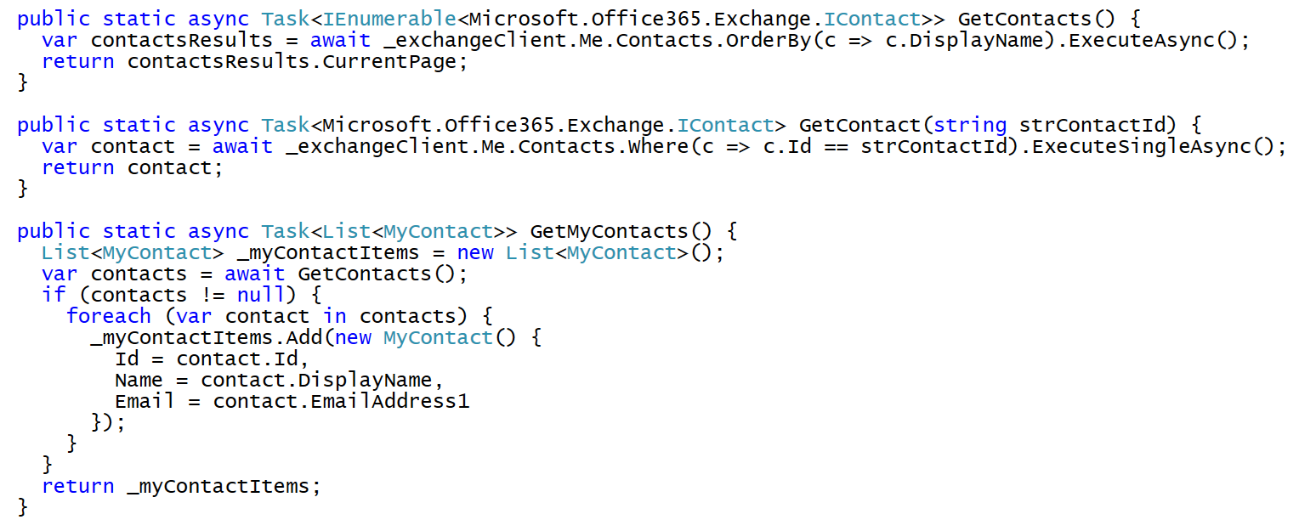
Programming with Office 365 Contacts

Slide 31
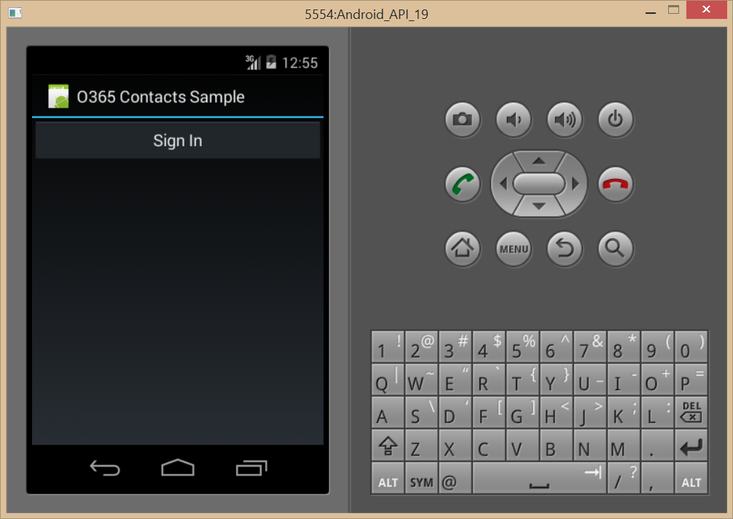
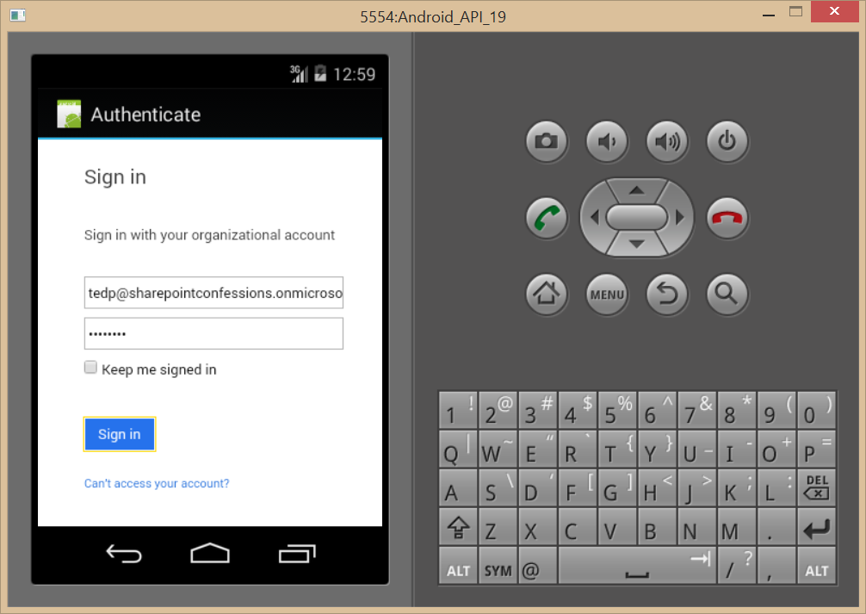
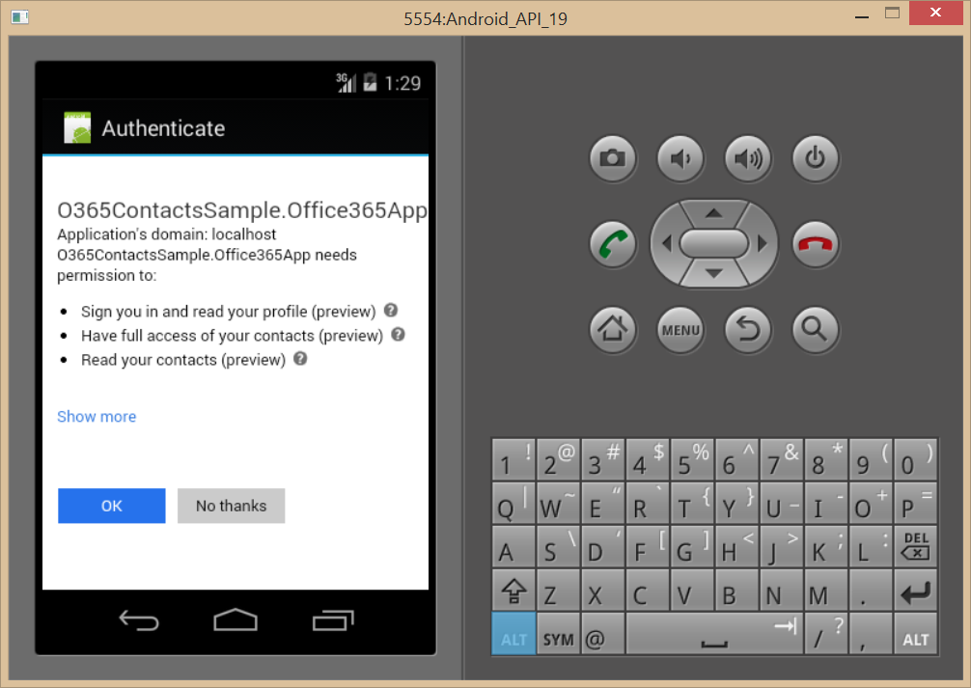
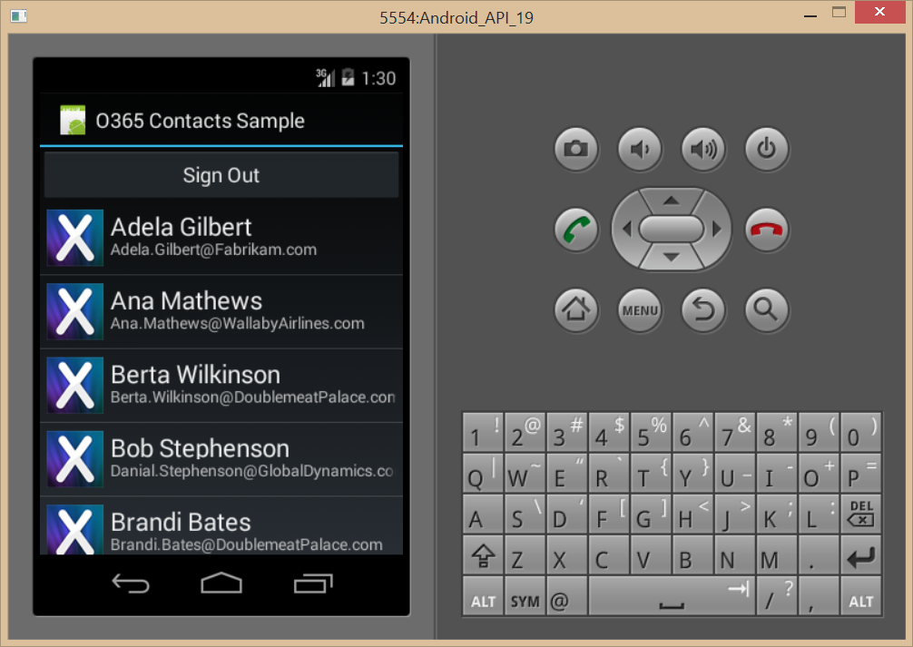
Authentication Flow

Slide 32
demo
Adding A Connected Service to a XAMARIN App

Slide 33
Creating Portable Xamarin Apps

Slide 34
Xamarin Cross-platform Development
Some things can be shared
Business logic
Code to access services across the network
Some things cannot be shared
Code that manages the user experience because Android, iOS Windows Phone are very different

Slide 35
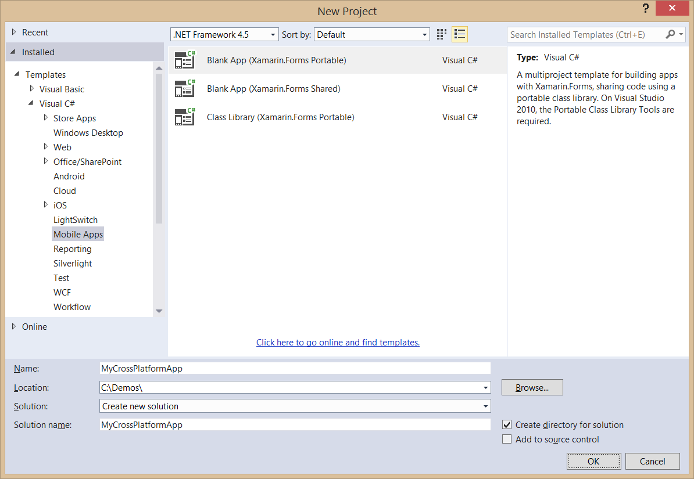
Creating a Xamarin Cross-Platform Solution

Slide 36
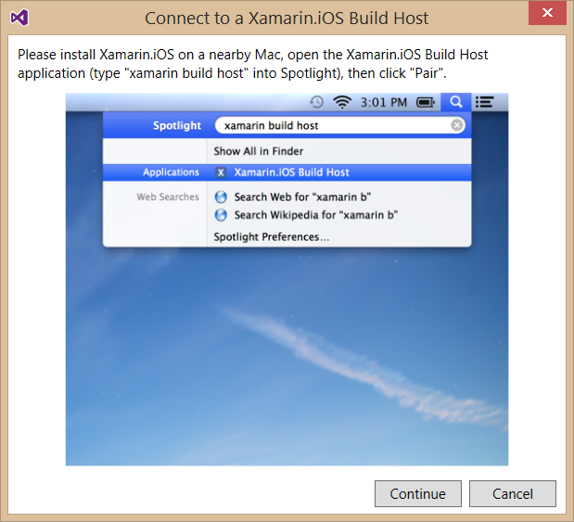
Integrating an iOS Project
To build iOS apps you will needs a Mac
Xamarin product orchestrates communication between Mac and Windows
Windows PC with Visual Studio pairs with Mac computer
Builds and debugging sessions can be initiated from Visual Studio
App compilation done on the Mac

Slide 37
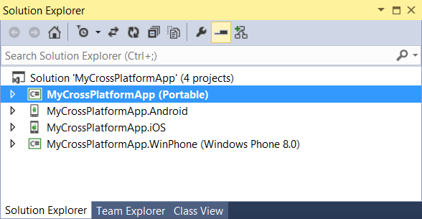
Portable Xamarin Solutions
Common code goes into portal library
Each platform gets its own project and debug targets
Connected Services Add to platform projects

Slide 38
demo
Examining a Xamarin Cross-Platform Solution

Slide 39
Summary
Xamarin Development Overview
Developing Xamarin Apps
Developing for Office 365
Creating Portable Xamarin Apps

Slide 40

© 2012 Microsoft Corporation. All rights reserved. Microsoft, Windows, and other product names are or may be registered trademarks and/or trademarks in the U.S. and/or other countries.
The information herein is for informational purposes only and represents the current view of Microsoft Corporation as of the date of this presentation. Because Microsoft must respond to changing market conditions, it should not be interpreted to be a commitment on the part of Microsoft, and Microsoft cannot guarantee the accuracy of any information provided after the date of this presentation. MICROSOFT MAKES NO WARRANTIES, EXPRESS, IMPLIED OR STATUTORY, AS TO THE INFORMATION IN THIS PRESENTATION.

